Slide 1
SE 577 Software Architecture API Architecture

Slide 2
A historical context
1940s
1960s
1970s
1980s
1990s
2000s
2010s
2020s
CORBA (1991)
XML RPC (1998)
Personal Computer
Computers Did One Thing at a Time for the Most Part
Early days of Networking TCP/IP Invented
Client Server (late ‘80s)
Web Services Rebranded as APIs(2020)
SOAP Web Services(2000)
REST Web Services(2004)
GraphQL(2015)
Socket Based Programming
Enterprise Java Beans (1998)
REST Web Services(2016)
Introduction of Time Sharing Computer Resources Could Be Shared
HTTP/1
HTTP/1.1
HTTP/2
HTTP/3
Distributed Objects
HTTP Based Transports for APIs
Internet / WWW Era
PRE DISTRIBUTED COMPUTING
POST DISTRIBUTED COMPUTING

Slide 3
Versions of Distributed Client/Server Interoperability
Client
Socket
Server
Roll your own Distributed Program
No Standard Wire Format
CORBA/EJB
Client
Socket
CORBA/EJB Server
Distributed Objects
STUB
PROXY
Quasi- Standard Wire Format
API Client
HTTP
API
Server
Client/Server Over Web Protocols
Standard Wire Format

Slide 4
Architecture Challenges addressed with modern Web-Based APIs
Client
Server
No tooling, develop at a very low level
Client and server very tightly coupled because of no OSI standard layer 7 protocol
No support for resilience and scale
Socket
Roll your own Distributed Program
No Standard Wire Format
Provides some benefits, tooling to serialize/deserialize objects
CORBA multi-language, EJB just Java
Provides higher level lifecycle services such as transactions
Interoperability was largely vendor specific / many didn’t follow standards
Vendor specific ways to manage resilience and scale
CORBA/EJB
Client
Socket
CORBA/EJB Server
Distributed Objects
STUB
PROXY
Quasi- Standard Wire Format
Other Object Request Broker Services (e.g., Transactions)
API Client
HTTP
API
Server
APIs ride over all of the innovations and scale that the internet provides
APIs are interoperate because the HTTP protocol is consistently implemented
Vendor differentiation moved to tooling and injecting API specific features into middleware that don’t impact interoperability (e.g., Load Balancing, Traffic Routing, etc)
Client/Server Over Web Protocols
Standard Wire Format

Slide 5
Architecture Challenges addressed with modern Web-Based APIs
Client
Socket
Server
Roll your own Distributed Program
No Standard Wire Format
THESE ARE INTERESTING HISTORICALLY BUT WE WILL NOT BE DISCUSSING IN CLASS
CORBA/EJB
Client
Socket
CORBA/EJB Server
Distributed Objects
STUB
PROXY
Quasi- Standard Wire Format
Other Object Request Broker Services (e.g., Transactions)
API Client
HTTP
API
Server
Client/Server Over Web Protocols
OUR AREA OF FOCUS
Standard Wire Format

Slide 6
The Primary Architecture Pattern of Modern APIs is Client/Server and Layered
WEB BROWSER
HTTP(s) over TCP/IP
WEB SERVER
HTTP(s) over TCP/IP
Request / Response Serialization
API Client Code
API Server Code
Request / Response Serialization
Operating System
HTTP Server Libraries
HTTP Client Libraries
Open Source Libraries
Open Source Libraries
Operating System
If we consider the basic web architecture as a black box (top), we can see that the architecture of APIs basically can ride on top. Think about all of the innovations over the past 10 years to deploy, manage, scale and run web applications, APIs get all of the benefits out-of-the-box. As well as future ones that may come later.

Slide 7
Lets start by taking a look at network protocols – Why?
Network protocols have interesting architectures
Understanding aspects of network protocols will lead to a deeper foundational understanding of web services and APIs
This material will also help with some other content covered in this class – web architectures, cloud native architectures, reactive architectures in particular

Slide 8
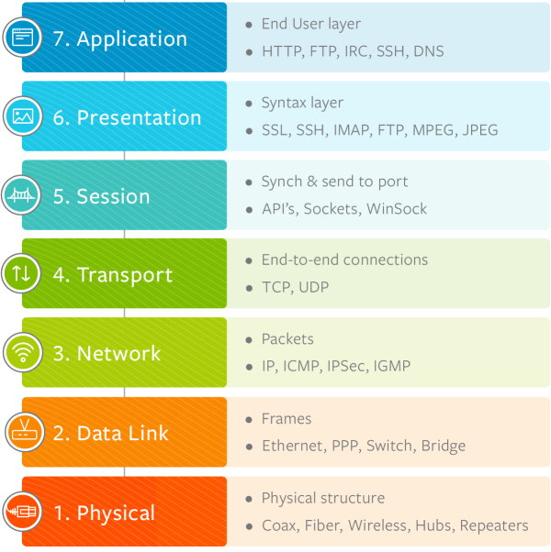
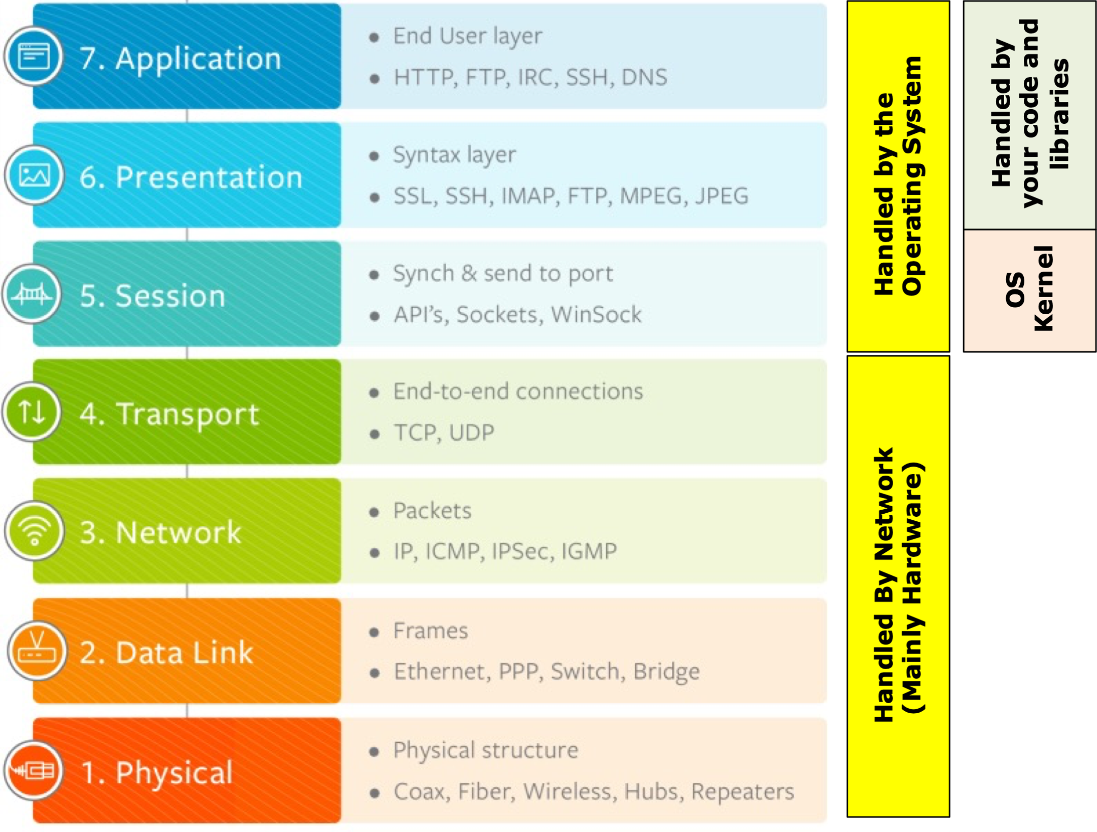
Modern APIs take advantage of the OSI Model from the 1970s – a Layered Architecture
Handled by your code and libraries
API Clients & Servers
Handled by the Operating System
OS Kernel
Handled By Network (Mainly Hardware)

Slide 9
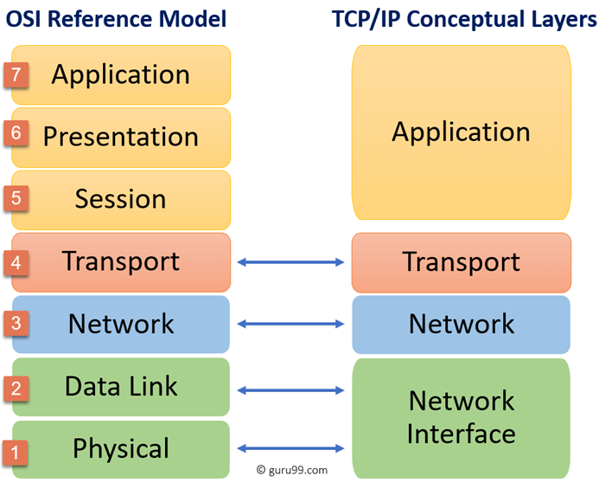
OSI architecture mapped to TCP/IP and UDP/IP
OSI is a REFERENCE ARCHITECTURE; TCP/IP is a concreate architecture
TCP/IP Representative Layers
HTTP TLS
TCP
UDP
IP
Internet
Ethernet WiFi MoCA

Slide 10
TCP vs UDP (this will be helpful later)
TCP
UDP
Rides on top of IP – IP Routes packets
Designed in the 1970s, adopted as a standard in the 1980s
TCP is a connection-oriented protocol –aka Connections are stood up, used and torn down
TCP provides a variety of different services
Like TCP, Rides on top of IP – IP Routes packets
Designed in the 1970s, standardized in 1980
TCP is a connectionless protocol –aka Connection setup is not required, you just send messages
Since its connectionless, its significantly faster than TCP, and includes other features not found in TCP, and supports use cases that don’t require TCPs features
Reliable delivery
Congestion control
Messages delivered in order
Due to efficiency, many use cases can absorb packet loss – e.g., video streaming
Support for broadcast and multicast, TCP is generally peer to peer
In many cases the performance benefits of UDP don’t matter, the main place TCP differs from UDP is connection setup. TCP connection setup requires 3 messages, TCP with TLS connection setup requires 8 messages. UDP has no connection setup requirement! APIs are very heavy in connection setup and tear down!

Slide 11
HTTP has variations V1.1, 2, and 3 (emerging)
HTTP/1 Text Based
HTTPS/1
Text Based
HTTP/2
Binary
HTTP/3
Binary
TLS
TLS
QUIC
TCP
TCP
TCP
UDP
IP
IP
IP
IP
Ethernet WiFi MoCA
Ethernet WiFi MoCA
Ethernet WiFi MoCA
Ethernet WiFi MoCA
1997 Note HTTP/1 is really version 1.1 – 1.0 deprecated
1997
2015
Not officially Released – Reference Implementations Exist

Slide 12
HTTP Protocol - L7 of OSI; App layer of TCP/IP
HTTP VERB
PARAMETERS PROTOCOL
GET https://api.github.com/users/ArchitectingSoftware HTTP/1.1
The current HTTP verb set is GET, POST, PUT, PATCH, DELETE, CONNECT, OPTIONS, and TRACE
HEADERS
Headers are key/value pairs that provide metadata on what is being request, or what is being retuned. Example: “content-length: 350”. See https://developer.mozilla.org/en-US/docs/Web/HTTP/Headers for details. Note you can add custom headers but they should start with x- for example “x-course-id: se577”
Payload
HTTP itself says nothing about its payload structure and format. The payload can be HTML, JSON, etc HTTP/1.1 specifies that the payload is not binary, so if binary data is sent over HTTP/1.1 it must be base-64 encode. HTTP/2 and HTTP/3 use binary formats for the payload which are more efficient to send over a network.
Also note the https:// in the above example. With HTTP/1.1 sending data encrypted is optional so HTTPS indicates secure where HTTP is just plain text. With HTTP/2 and HTTP/3, https is the only option, as non encrypted headers and payloads are not supported

Slide 13
HTTP Protocol Versions Can be Negotiated Client Requested Example
One cool feature of HTTP is that via headers and status codes, HTTP protocol versions can be negotiated between clients and servers. HTTP status codes are well defined in the standard. See https://developer.mozilla.org/en-US/docs/Web/HTTP/Status
-> GET foo.com HTTP/1.1 <- Status-Code: 200/OK
-> GET foo.com HTTP/1.1 Upgrade: http/2 Connection: Upgrade <- Status-Code: 101/Switching-Protocols Upgrade: http/2
Simple exchange, server supports protocol requested by client
Client requests server to upgrade to http/2, server indicates that upgrade is OK
-> GET foo.com HTTP/1.1 Upgrade: http/3, http/2 Connection: Upgrade <- Status-Code: 101/Switching-Protocols Upgrade: http/2
Client requests server to upgrade and gives server a preferred list of protocols, server picks the one it wants and returns it

Slide 14
HTTP Protocol Versions Can be Negotiated Server Enforced Example
One cool feature of HTTP is that via headers and status codes, HTTP protocol versions can be negotiated between clients and servers. HTTP status codes are well defined in the standard. See https://developer.mozilla.org/en-US/docs/Web/HTTP/Status
-> GET foo.com HTTP/1.1 <- Status-Code: 426/Upgrade-Required
Upgrade: http/3, http/2
-> Get foo.com HTTP/1.1 Upgrade: http/2 Connection: Upgrade
<- Status-Code: 101/Switching-Protocols Upgrade: http/2
-> GET foo.com HTTP/1.1 <- Status-Code: 426/Upgrade-Required
Upgrade: http/2
-> Get foo.com HTTP/1.1 Upgrade: http/3 Connection: Upgrade
<- Status-Code: 505/HTTP-Version-Not-Supported Upgrade: http/2, http/1.1
Client wants to use 1.1, but server responds that it supports http/3 and http/2 with http3 being preferred
Client then initiates protocol transfer to what it wants, http/2 in this case
The client is trying to upgrade to http/3 but the server does not support it, so it returns a 505 with a list of protocols it supports in preferred order

Slide 15
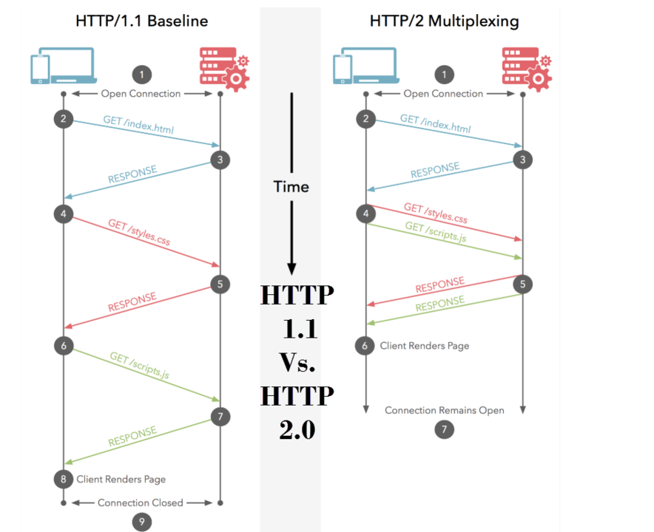
HTTP Evolution – 1.1 to 2.0
HTTP/1.1 sets up and tears down a TCP/IP connection for each request; HTTP/2.0 sets up a persistent connection and keeps it open – big benefits:
Consider a web page or making multiple API calls, TCP setup is expensive
Allows requests to be multiplexed (see picture on left) vs making one request at a time serially
HTTP/2.0 is a binary protocol, which is more efficient to send over the wire than text, which is the HTTP/1.1 standard
HTTP/2 only supports encrypted traffic; this is optional in HTTP/1.1 via http vs https – note HTTP/2 supports non-encrypted payloads for localhost testing only

Slide 16
HTTP Evolution – 2 to 3 – Still under development
Super novel ideal, proposed by Google and working its way through the standards bodies:
Architecturally, TCP really cant be replaced given its baked into intermediary router hardware, it can only be bypassed by using UDP
QUIC provides connection reliability just like TCP
TCP is 40 years old, and has to be general enough to handle any network traffic
We also have 20 years of experience with HTTP and can benefit from a modern connection-oriented protocol that is purposed built for Web and API traffic vs general traffic
Like HTTP/2 encryption is not optional
QUIC can adjust behavior based on connection quality – think wired, vs wifi, vs mobile
HTTP/2
Binary
HTTP/3
Binary
TLS
QUIC RFC9000
TLS
TCP
UDP
IP
With HTTP/3, QUIC replaces TCP for establishing reliable connections
Between clients and servers

Slide 17
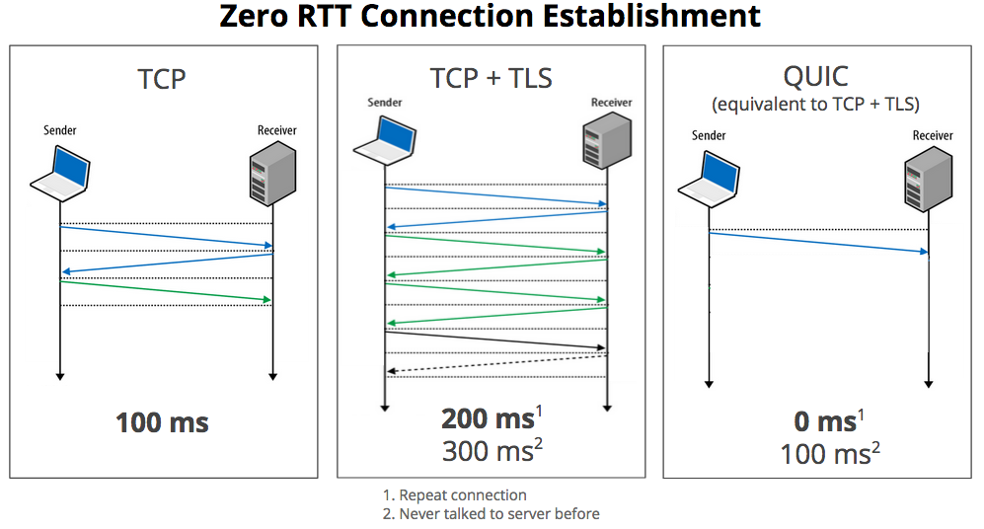
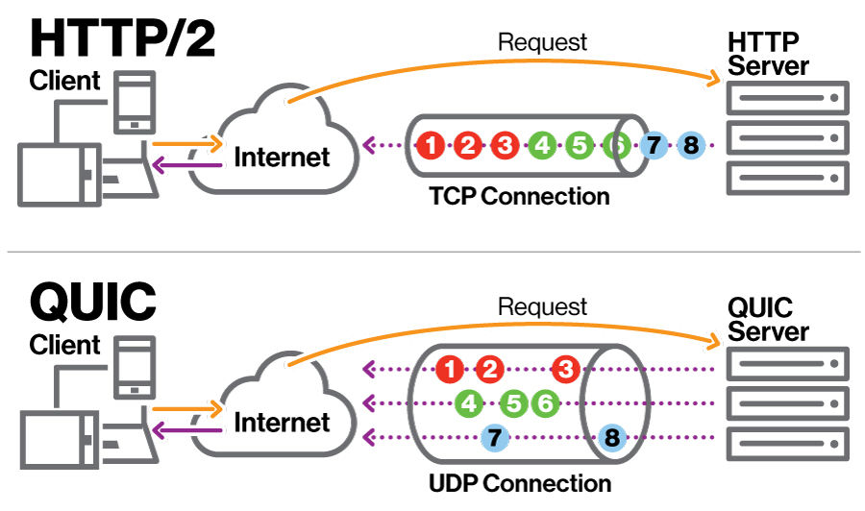
Specific Benefits of QUIC vs TCP for HTTP
BIG BENEFIT #2
Since QUIC uses fast and cheap UDP connections it can use individual UDP sockets to multiplex client calls, since TCP is expensive to setup, multiplexing gets serialized on the TCP connection, leading to buffering inefficiencies such as “head of line” blocking
BIG BENEFIT #1
Since QUIC has knows both sides of the connection will be encrypted it does not have to negotiate it, improving connection setup time dramatically

Slide 18
Wrapping up HTTP
COMMUNICATION PACKET STRUCTURE
PROTOCOL AWARE HEADER
PROTOCOL PAYLOAD – Protocol only tracks length but is just a basic byte array
THUS protocols can be “stacked” where a nested protocol can be put in the payload of a parent protocol
IP
TCP
HTTP
HTTP/1.1 and HTTP/2
IP
UDP
QUIC
HTTP
HTTP/3

Slide 19
BACK to APIs now that we covered HTTP
HTTP(s) over TCP/IP
Request / Response Serialization
API Client Code
API Server Code
Request / Response Serialization
Operating System
HTTP Server Libraries
HTTP Client Libraries
Open Source Libraries
Open Source Libraries
Operating System
OUR FOCUS NOW SHIFTS HERE
OUR FOCUS NOW SHIFTS HERE

Slide 20
Certain aspects of API architectures have evolved over the past 20 years, others have not changed…
WHAT HAS NOT CHANGED: The basic architecture shown BELOW has not changed in the past 20 years. One or more API Clients interact with One or more API servers. In general, the number of API clients exceeds the number of API servers dramatically
HTTP(s) over TCP/IP
Request / Response Serialization
API Client Code
API Server Code
Request / Response Serialization
Operating System
HTTP Server Libraries
HTTP Client Libraries
Open Source Libraries
Open Source Libraries
Operating System
MANY
FEW
WHAT HAS CHANGED: (1) VOLUME – 20 years ago we measured volume in dozens of concurrent connections and hundreds-of-thousands to low millions of calls per year… now we measure volume in thousands of concurrent connections and billions of calls per year. (2) PERFORMANCE – 20 years ago 3-5 seconds was acceptable, now anything over 500 ms is considered slow, we target under 100ms in general. (3) RESILIENCY – 20 years ago 95+% availability was OK; now anything less than 99.9% is considered bad. (4) SECURITY – 20 years ago APIs were internal only, now they are a major attack vector so security is essential.

Slide 21
API Components
API Client/Server Code
For API-based architectures we need:
A way to serialize and deserialize data structures that will be exchanged between the client and server that is language agnostic
Libraries that provide simple abstractions to send and receive data without knowledge of the underlying network protocol requirements
The ability to support important resiliency patterns such as health checks, retries, timeouts, circuit-breakers, etc given this is a distributed system
The ability to observe and trace distributed calls end-to-end for performance optimization and debugging
The ability to supervise servers to ensure that they are running and are healthy, and to automatically restart and scale them out as needed
The ability to ensure that the clients and servers trust each other from a security perspective, and are hardened to common attacks
Request / Response Serialization
Open Source Libraries
HTTP Libraries
Operating System

Slide 22
XML-RPC and SOAP (late ‘90s – early ‘00s)
IP
TCP
HTTP
SOAP
For the most part, SOAP was a protocol encapsulated in HTTP and was sent from clients to servers in an HTTP POST
Like all other protocols, SOAP separated Headers that were used as Metdata, from the payload which was used to communicate request calls, and responses in XML
EXAMPLE: A SOAP REQUEST
<?xml version="1.0"?>
<soap:Envelope xmlns:soap="http://www.w3.org/2003/05/soap-envelope">
<soap:Header>
<h:LevelOfDetail> Summary </h:LevelOfDetail>
</soap:Header>
<soap:Body>
<m:GetUser>
<m:UserId>123</m:UserId>
</m:GetUser>
</soap:Body>
</soap:Envelope>
SOAP Header
SOAP Payload (any XML)
SOAP Structure

Slide 23
XML-RPC and SOAP (late ‘90s – early ‘00s)
IP
TCP
HTTP
SOAP RESPONSE
SOAP RESPONSES TOOK THE SAME STRUCTURE AS A REQUEST BUT HAD AN OPTIONAL OTHER VERB CALLED A “FAULT” THAT COULD BE RETURNED IF AN ERROR HAPPENED
EXAMPLE: A SOAP RESPONSE
<?xml version="1.0"?>
<soap:Envelope xmlns:soap="http://www.w3.org/2003/05/soap-envelope">
<soap:Header>
<h:LevelOfDetail> Summary </h:LevelOfDetail>
</soap:Header>
<soap:Body>
<m:GetUserResponse>
<m:First-Name>B rian</m:First-Name>
<m:Last-Name>Mitchell</m:Last-Name>
<m:Gender>Male</m:Gender>
<m:OtherStuff>Foo-Bar</m:OtherStuff>
</m:GetUserResponse>
</soap:Body>
</soap:Envelope>
SOAP Header
SOAP Payload (any XML)
SOAP Structure

Slide 24
XML-RPC and SOAP (late ‘90s – early ‘00s)
IP
TCP
HTTP
SOAP RESPONSE
SOAP RESPONSES TOOK THE SAME STRUCTURE AS A REQUEST BUT HAD AN OPTIONAL OTHER VERB CALLED A “FAULT” THAT COULD BE RETURNED IF AN ERROR HAPPENED
EXAMPLE: A SOAP RESPONSE WITH A FAULT
<?xml version="1.0"?>
<soap:Envelope xmlns:soap="http://www.w3.org/2003/05/soap-envelope">
<soap:Header>
<h:LevelOfDetail> Summary </h:LevelOfDetail>
</soap:Header>
<soap:Body>
</soap:Body>
</soap:Fault>
<Code>1234</Code>
<Message>User Not Found</Message>
</soap:Fault>
</soap:Envelope>
SOAP Header
SOAP Payload (any XML)
SOAP Structure

Slide 25
SOAP Protocol
The Soap protocol used XML and wrapped SOAP messages in the <Envelope> tag
The <Envelope> tag was allowed to encapsulate the <Header>, <Body>, and <Fault> tags
ISSUES
The data contained under the standard tags was not standardized beyond having to be valid XML, thus techniques had to be used to communicate data schema expectations between the client and the server
Every request customized what was expected of the server, and every response had to react to the request
XML processing is verbose and tends not to be super performant for large payloads
SOAP was encapsulated inside of the HTTP packet, yet it took zero advantage of the HTTP protocol itself

Slide 26
What about Security with SOAP?
<soapenv:Header>
<wsse:Security xmlns:wsse="http://...oasis-200401-wss-wssecurity-utility-1.0.xsd"> <wsse:UsernameToken wsu:Id="UsernameToken-1">
<wsse:Username>login</wsse:Username>
<wsse:Password Type="http://...#PasswordText">XXXX</wsse:Password> </wsse:UsernameToken>
</wsse:Security>
<soapenv:Header>
Since SOAP is a protocol, security assertions are defined in a standard way nested under the SOAP header
A variety of different security schemes have been standardized including basic authorization (shown above),and SAML
Because SOAP is embedded in HTTP, any SOAP messages with security should be transmitted encrypted – SOAP doesn’t do encryption, HTTPS is utilized

Slide 27
SOAP – Design by Contract
To address the fact that every SOAP request and response could be structured in any way, best practice evolved to “design by contract”
The definition of the structure and semantics of requests and replies was defined in an XML quasi-schema language called XSLT
Tools parsed XSLT and generated custom proxies and stubs to serialize and deserialize to SOAP request and response structures
SOAP Client Code
SOAP Runtime
XSLT Definition (in XML)
XSLT Compiler
Serialization and Deserialization Code
SOAP Server Code

Slide 28
SOAP – Challenges with SOAP Design
SOAP clients made request to the SOAP server using “verbs”, AKA – go do this, go do that, which lead to massive sprawl and no standards for how to interoperate
GetCustomerByFirstName, GetCustomerByID, GetCustomerByAddress, …
SOAP did not use any of HTTP to manage traffic, scale, routing, etc so custom SOAP servers were required – e.g., IBM WebSphere, etc. Each one of these customer vendor offerings had their own story around how/why they scaled and ran better than other vendor offerings
Because the serializers, and deserializers were provided by the vendor there were interoperability challenges if you tried to use code compiled against IBM Websphere with BEA Weblogic – this was by vendor design
XML lead to big payloads, and in the early 2000’s networks were not what they are today

Slide 29
SOAP – Architecture Summary
Feature | Description | Architecture Implications
Protocol | SOAP is a well defined protocol, consisting of a header and a body/payload, most of the time encapsulated in HTTP | Given SOAP rides on HTTP, and we know how to scale HTTP, SOAP scales Since its a “wrapped” protocol, we need libraries to encode/decode SOAP messages, these libraries can be of varying quality and performance
Payload / Encoding | The SOAP standard specifies XML as the standard encoding | Unlike other protocols we will look at that offer multiple encoding types, SOAP is XML-Only XML includes many nice features such as schema definition and enforcement XML is bulky, can lead to performance issues to parse and transmit, especially over mobile networks
Client/Server Semantics | SOAP requests tend to be biased towards “do this”, or “do that”. In other words they are verbs | Given the types of operations that generally come up in real applications, the number of actions we want to expose tend to become large, having a SOAP API for each one of them leads to MANY APIs APIs could be reduced by developing complex request schemes that convey semantic intent
Current Status of SOAP | SOAP has been replaced by REST (discussed next) as a best practice, but well performing SOAP APIs don’t require replacement | SOAP has proven to be able to support modern workloads – many organizations still maintain and extend SOAP services, and they work fine Newer techniques have proven to be simplier, so they are common practice these days

Slide 30
Then came REST
1998
2000
2004
2008
2020
THE FALL OF SOAP
THE RISE OF SOAP
THE RISE OF REST
REST WINS
XML RPC Introduced
Roy Fieldings PhD work implemented – REST born
The REST vs SOAP DEBATE Plays out
Other alternatives to REST introduced – GRPC, GraphQL but REST still the most common API technique
XML RPC Standardized as SOAP Roy Fielding PhD Publshed
SOAP Services go into “maintain” mode, just about all new APIs developed in REST

Slide 31
REST 101 – What is a Resource? It’s the most important concept that you need to know
A resource is an abstract concept that can be thought of as anything important enough to be referenced as a thing in itself
They are generally identified by mining for nouns in your design space. E.g, persons, users, locations, items, orders, etc
Resources can also be thought of as entities in a database, thus they come in collections – notice above I refer to them in Plural form, not singular form
Because they come in collections, resources should be uniquely identifiable – think of an ID or a Key
Resources are naturally hierarchical, a resource can be linked to one or more child resources, which in turn could have children (a tree)

Slide 32
REST 101 – Representing a resource in REST
A resource in REST is directly mapped to the HTTP protocol
HTTP_VERB LOCATION/RESOURCE-COLLECTION/ID?PARAM-KEY=PARAM-VALUE&... HTTP/VERSION
HEADERS ...
PAYLOAD ..l
GET api.github.com/users/ArchitectingSoftware HTTP/1.1
HTTP VERB MEANING GET: Query PUT: Create PATCH: Update DELETE: Deleate
GET api.github.com/users/ArchitectingSoftware/Repos HTTP/1.1
PATCH api.github.com/users/ArchitectingSoftware HTTP/1.1 HEADERS ... PAYLOAD { updated_user_json}
HTTP RESOURCES
GET: Query for 1…n PUT: Create 1
PATCH: Update 1 DELETE: Delete 1
PUT api.github.com/users/ArchitectingSoftware2 HTTP/1.1 HEADERS ... PAYLOAD { new_user_json}

Slide 33
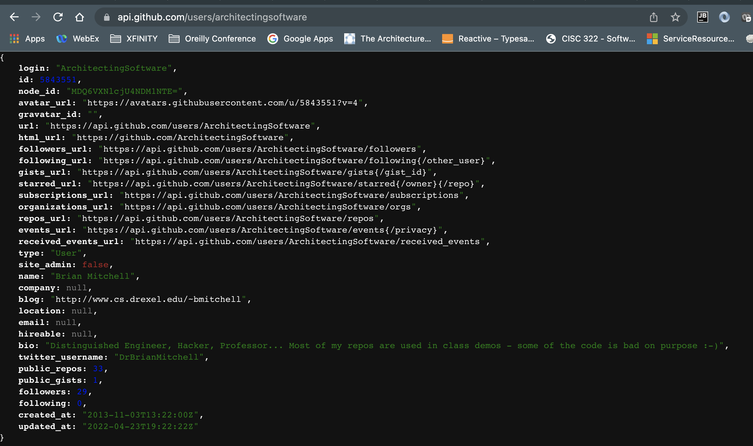
REST 101 – Example

Slide 34
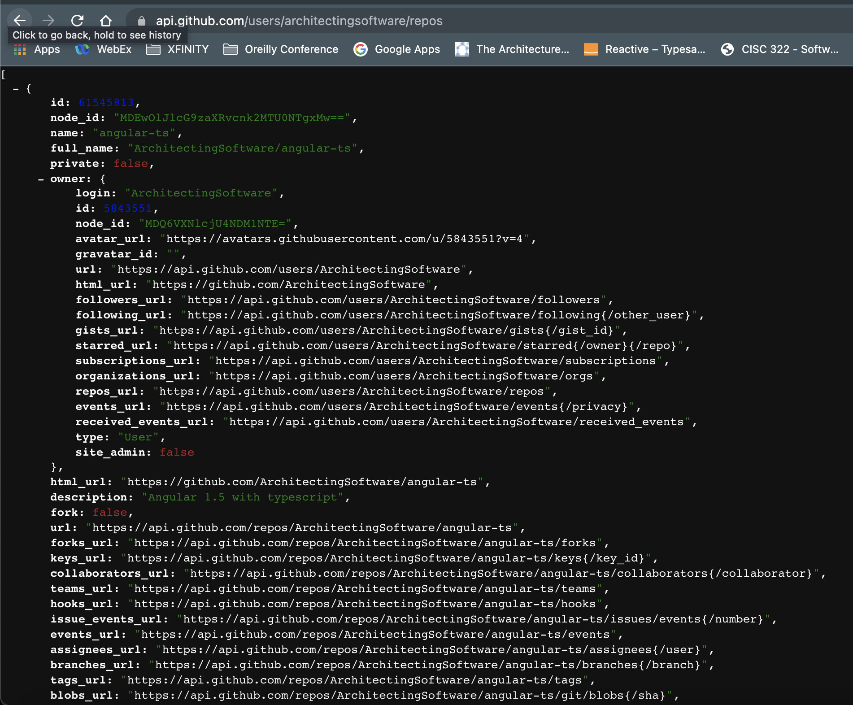

REST 101 – Example
Nested Resource Example GET api.github.com/users/ArchitectingSoftware/repos
Notice the LINK header that GitHub returned – because it didn’t return the entire collection, it gives
you links to the next and last page to support navigation/pagnation THIS IS CALLED HYPERMEDIA

Slide 35
REST is like SOAP, but simplifies things, A LOT
Feature | Description | Architecture Simplification Implications
Protocol | SOAP was a custom protocol encapsulated in HTTP, REST uses HTTP directly | Eliminates the need for software that can build and understand SOAP protocols Eliminates a layer, leads to better performance
Payload / Encoding | The SOAP standard specifies XML as the standard encoding, REST makes no claim on payload encoding, just uses HTML content-type header to describe | SOAP is XML, Early REST was also XML, but could be easily migrated to anything else, these days JSON, which is more compact is the standard JSON is more compact, easier to parse, and is naturally aligned to the web architecture – javascript objects are JSON
Client/Server Semantics | SOAP semantics are “verb” based – do this, do that. REST semantics are Noun based, here is a structure, and here is how I want to operate on it. | Verb based semantics based lead to a significant API sprawl, where each operation lead to its own service, or complex request semantics to convey intent Noun semantics simplified things a lot, REST operates on resources/entities, and uses standard HTTP Verbs– GET, POST, PATCH, DELETE to query and manipulate them (think CRUD)
Evolvability | SOAP being a custom protocol is supported by libraries “compiled into” the services themselves. Rest requires no libraries, it conforms to HTTP standards | SOAP can be difficult to version and evolve, quality depends on library implementations and their interoperability SOAP says nothing about how to negotiate protocol versions, this is built into the HTTP standard that REST uses

Slide 36
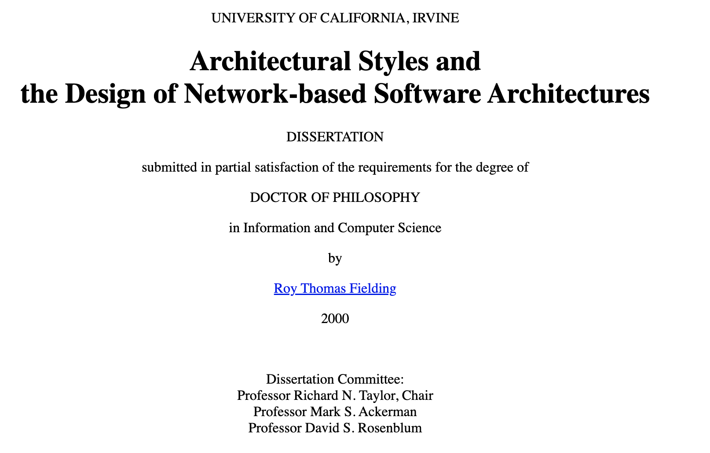
So where did the principals of rest come from?
At the same time engineers started to use SOAP, Roy Fielding wrote his PhD thesis (2000) that suggested an alternative architecture
By 2004 people were starting to play with this model, and it became the defacto-standard a few years later
It was called REST, REpresentional State Transfer
REST is an architecture for distributed hypermedia systems

Slide 37
Guiding Architecture Principals for REST
Uniform Interfaces in REST – REST manipulates RESOURCES
Resources are like objects in OO, or an entity in a DB
Identification: The interface must uniquely identify each resource
Manipulation: Servers should return resources to clients in a uniform way, and clients should use these representations in a standard way to manipulate the state of the resource
Self-Descriptive Messages: Resource messages should be self descriptive, they should not only contain information on the resource itself, but also include additional actions that a client can perform
Hypermedia as the engine of Application State (HATEOAS): The client should have only the initial URI of the application. The client application should dynamically drive all other resources and interactions with the use of hyperlinks

Slide 38
Guiding Architecture Principals for REST
Embrace the client/server architecture pattern
Put smarts in the endpoints – the client and server, and allow them to evolve independently
Separate the interface from the storage and resource lifecyle management concerns. Are resources stored in a database? A cache? Nowhere, just computational (e.g., my blockchain demo)?
Evolvability, discovery and versioning of interfaces. Keep interfaces compatible where it makes sense, make breaking changes on purpose
Statelessness
Statelessness mandates that each request from the client to the server must contain all of the information necessary to understand and complete the request.
This is a key attribute to scaling REST-based services

Slide 39
Guiding Architecture Principals for REST
Cacheable
The cacheable constraint requires that a response should implicitly or explicitly label itself as cacheable or non-cacheable
Done via the cache-control header. This header indicates if the resource is cacheable, and if so for how long, and if the caching can only happen at the client and server itself vs also at intermediaries.
Embrace, and don’t work around HTTP
Use HTTP to the fullest extent possible – headers, response codes, etc. HTTP works and scales so use it
API specific control data and detailed error messages can be exchanged as metadata on the API call. Generally this is done with X- headers or a custom “metadata{}” object in the response

Slide 40
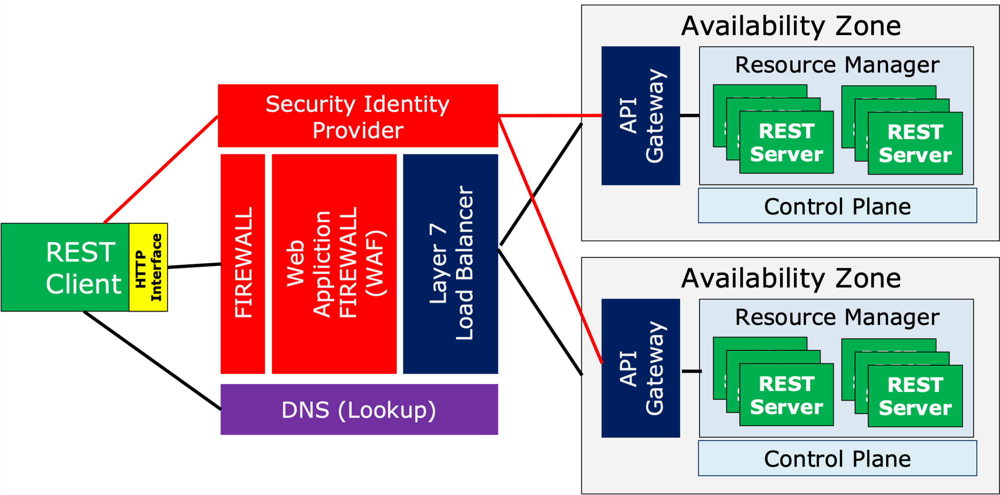
REST Architecture Components
Component | Description
REST Client | Component that makes API calls and receives responses from the REST Server
Firewall | Layer 2/3 firewall that deals with IP addressing, IP Routing and Port Filtering
WAF | Layer 7 (e.g, HTTP aware) firewall that supports protecting against HTTP attacks – SQL Injection, Bots, etc
L7 Load Balancer | Load balancer that distributes load and ensures health of downstream components – eg., the API Gateway. It works at Layer 7 so its optimized for HTTP protocol
Identity Provider (IdP) | A RESTFul security endpoint that handles authentication and authorization requests. Typically they issue tokens that can be used to assert trust
DNS | Location services for REST
API Gateway | An intelligent proxy that can load balance REST services, act as a security enforcement point, apply policies around traffic management and shaping, etc
Resource Manager/ Control Plane | An intelligent runtime that supervises running services. It can react to traffic congestion, errors, etc and can scale up/down running instances as needed
REST Server | Component that receives and processes REST Client calls

Slide 41
Reference Architecture for REST
Availability Zone
Resource Manager
Security Identity Provider
API Gateway
REST Server
REST Server
REST Server
REST Server
REST Server
REST Server
Control Plane
Web Appliction FIREWALL (WAF)
REST Client
Layer 7 Load Balancer
FIREWALL
HTTP Interface
Availability Zone
Resource Manager
API Gateway
REST Server
REST Server
REST Server
REST Server
REST Server
REST Server
DNS (Lookup)
Control Plane

Slide 42
Current State of REST
The RESTful architecture for APIs is considered best practice currently
However, there are some things that REST does not do well, so some options exist
Type safety for data structures
Data structure discovery
Sometimes request/reply semantics do not fit our needs
Support for streaming
Conventions for handling things like paging, filtering, etc

Slide 43
Current State of REST – Some challenges
Example REST Response – from one of the demos I have been using Challenge is around data structures and data types
{
"blockHash": "000bac8172d58c3c0c2a25e1deafadd6a225e2ebdd75b412ae3e8de39b3234a6",
"blockId": "18f3a534-3f69-469d-bc22-981a01d12ac2",
"executionTimeMs": 6,
"found": true,
"nonce": 6922,
"parentHash": "00000000000000000000000000000000",
"query": "hello-there”
}
How do I know that these attributes are returned from the API? For the most part, this is handled via documentation in REST
How do I know which fields are strings, booleans, numbers, etc? For the most part this is handled via documentation in REST
RESTFul models generally rely on documentation to define resource structures, header standards,
Data types, etc. This is just the way it is, but there is some good tooling out there to generate documentation from code like swagger. There are also other solutions, although not widely used to help with this – google “JSON Schema”

Slide 44
Current State of REST – Some challenges
Example REST Request – I used this earlier to demonstrate
Challenge is large collections
GET api.github.com/users/ArchitectingSoftware/repos
Sometimes REST responses deal with, and need to return, large collections. Best practice is to use custom paging technique. Some common practices
Use the standard Link header to specify links to get the first, previous, next and last pages – Github uses this technique
Use GET parameters like limit and offset to self navigate. For example: …/users/ArchitectingSoftware/repos?limit=5&offset=10 to return items 10-15
How do I know the technique used for managing large collections with paging? You got it, read the documentation?

Slide 45
Current State of REST – Some challenges
Example REST Request – I used this earlier to demonstrate
REST is Uni-Directional Request/Reply
-> GET api.github.com/users/ArchitectingSoftware/repos
...SOME TIME <- { RESULTS }
REST by its very nature is request/reply. Everything is requested from the client, and fulfilled by the server – sometimes this does not meet your needs
For other situations, REST is not a good solution, but there are ways to support these things:
What if I want to be notified directly from the server when something happens? Solutions: HTTP server push, only on HTTP/2+, Webhooks
What if I want to keep a long connection open between the client and server for something like a chat application. Solution: Websockets

Slide 46
Current State of REST – Some challenges
Example REST Request – I used this earlier to demonstrate
Streaming Requests and Responses
Sometimes a client may want to stream data to a server, or a server might want to stream data to a client.
REST by its definition really does not support this concept given it expects a well defined request and a well defined response.
REST responses can be large collections, rather than sending the entire result, it can be paged
Its interesting how REST does not support streaming but HTTP does. In HTTP/1.1 there was a simple streaming standard that used a special header, Transfer-Encoding: Chunked. HTTP/2 supports streaming in its core protocol, but REST really doesn’t take advantage of it

Slide 47
REST Summary
Even with all of the shortcoming highlighted, REST is the defacto standard these days given its proven to run reliably, at scale, and has very good tooling to support creating APIs following the REST architecture principals.
There are many good resources on the web to learn more about best practices for RESTful design and architecture. Here is just one: https://docs.microsoft.com/en-us/azure/architecture/best-practices/api-design

Slide 48
Modern REST Alternative 1 - GRPC
See: https://grpc.io/
What if you could improve the performance of REST by more than 10x, and introduce type safety at the same time? Interested?
GRPC was introduced by Google in 2016 and is an essential component in any modern web service architecture
GRPC has an amazing feature set, but has one significant caveat that currently positions it as a complement to REST, and not a replacement for REST.
GRPC Protobuf File
PROTOBUF COMPILER
GENERATE
GENERATE
GRPC Client
GRPC Server
STUB
PROXY

Slide 49
GRPC Architecture
With GRPC you define your client/server interactions in a protobuf file
You then compile that protobuf file into code that can be imported into your client and server. This code facilitates all the communication
If you are using a strongly typed language, the generated code enforces this at compile time – a big benefit over REST
This architecture has been used many times before and has not worked out – MSRPC (2006), CORBA (1990s) – Whats Different? The communication between the client and server flows over HTTP/2 (vs TCP/IP sockets) – which works at amazing scale!
GRPC Protobuf File
PROTOBUF COMPILER
GENERATE
GENERATE
GRPC Client
HTTP2
GRPC Server
STUB
PROXY

Slide 50
What does a protobuf file look like?
syntax = "proto3";
package BCGrpc;
service BCSolver {
rpc BlockSolver (BcRequest) returns (BcResponse) {}
}
message BcRequest {
string query = 1;
string parent_block_id = 2;
string block_id = 3;
uint64 max_tries = 4;
string complexity = 5;
}
message BcResponse {
string block_hash = 1;
string block_id = 2;
int64 exec_time_ms = 3;
bool found = 4;
uint64 nonce = 5;
string parent_block_id = 6;
string query = 7;
}
Defines the client/server interactions
Defines the message structures and types
Note that each attribute has a unique number, that is used to optimize binary serialization and deserialization

Slide 51
What about Streaming?
service BCSolver {
rpc NoStreamHelloWorld (HelloReq) returns (HelloRsp) {}
rpc CliStreamHelloWorld (stream HelloReq) returns (HelloRsp) {}
rpc SvrStreamHelloWorld (HelloReq) returns (stream HelloRsp) {}
rpc BiDirectionStreamHelloWorld (stream HelloReq) returns (stream HelloRsp) {}
}
message HelloReq {
...
}
message HelloRsp {
...
}
GRPC includes the stream keyword to enable streaming, it can be one way or bidirectional
Under the covers native HTTP/2 streaming is used
GRPC Client
GRPC Server
STUB
PROXY
HTTP2

Slide 52
Why doesn’t GRPC just outright replace REST?
GRPC Supports Dozens of Different Programming Languages, even Javascript and Typescript;
But currently it CANNOT BE USED DIRECTLY FROM BROWSERS, which is a SIGNIFICANT BLOCKER for GRPC to directly replace REST
GRPC requires HTTP/2, and all modern browsers support HTTP/2
GRPC can generate Javascript, and all modern browsers support Javascript
ISSUE: The javascript engines embedded in browsers blocks access to the APIs that GRPC requires to manage HTTP/2 connections
Web Browser
HTTP/1.1
Browser Javascript Engine
PROTOCOL AND NETWORKING
HTTP/2
Your JS Code
x
GRPC STUB
Since the browser is the most common client these days, does this make GRPC useless?

Slide 53
Workarounds for Browser Restrictions on GRPC
An Open Source Project Exists to Enable GRPC from the web, its called Web-GRPC https://github.com/grpc/grpc-web I personally consider this a quasi-architecture-hack and don’t like it
Web Browser
HTTP/1.1
Browser Javascript Engine
HTTP/2
PROTOCOL AND NETWORKING
GRPC Server
WEB-GRPC OVER HTTP/2
GRPC OVER HTTP/2
Your JS Code
WEB-GRPC AWARE PROXY Nginx, Envoy
WEB- GRPC STUB
PROXY
GRPC-Web works around the restrictions of the browser javascript-http/2 APIs and emulates the functionality not supported. HOWEVER, this is not standard GRPC and you need to introduce a proxy to translate between GRPC-WEB and proper GRPC. If you are programming in GO there is a wrapper for GRPC that also supports GRPC-WEB that you can play with, but its only available in GoLang https://github.com/improbable-eng/grpc-web/tree/master/go/grpcweb

Slide 54
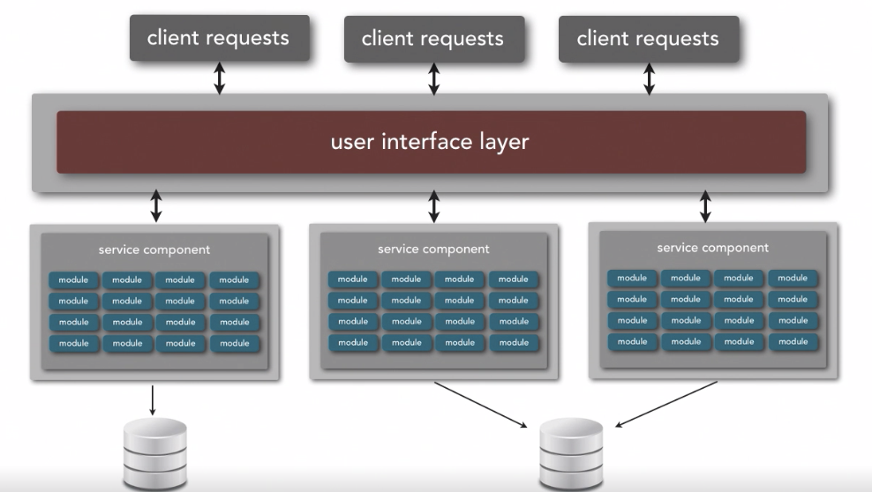
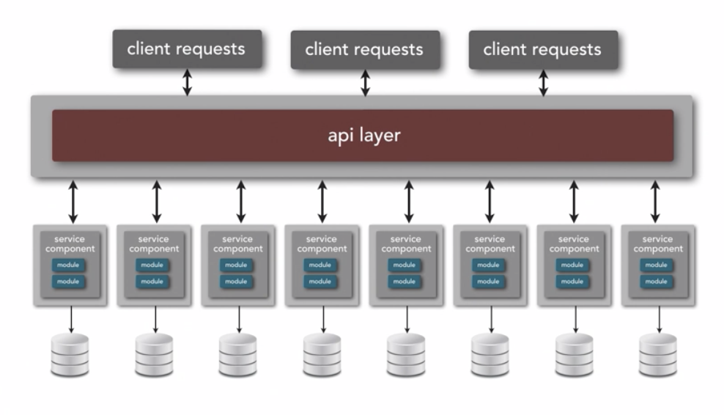
The GRPC Sweet Spot – GRPC Complements REST
Service Based Architecture Style
Microservice Architecture Style
REST
REST
GRPC
GRPC
This is a very common architectural approach – Use REST from the client to the service tier, and use GRPC for service-to-service APIs

Slide 55
Do you have to choose – GRPC or REST?
Servers can be built to handle either GRPC or REST – even over the same port! Given HTTP is used, we know its GRPC if its over HTTP/2 and Content-Type: application/grpc REST would be over HTTP/1.1 or HTTP/2 with Content-Type application/json
API Client GRPC or REST
API Server
REST Call
API Implementation f(req) : resp
Listen Port 123
GRPC Generated Types Used for Requests and Responses
GRPC Server
Setup
Expose Port 123
CALL
TCP/IP Multiplexer Look at Header to Route
Listen Port 123
REST Proxy Map JSON Requests and Responses to GRPC generated types
CALL
GRPC Call
Multiplexer probes HTTP protocol 1.1 or 2 and Content-Type Header to decide
To see a demo of this approach: https://github.com/ArchitectingSoftware/se577-webservices-demo/tree/main/grpc/combined-server

Slide 56
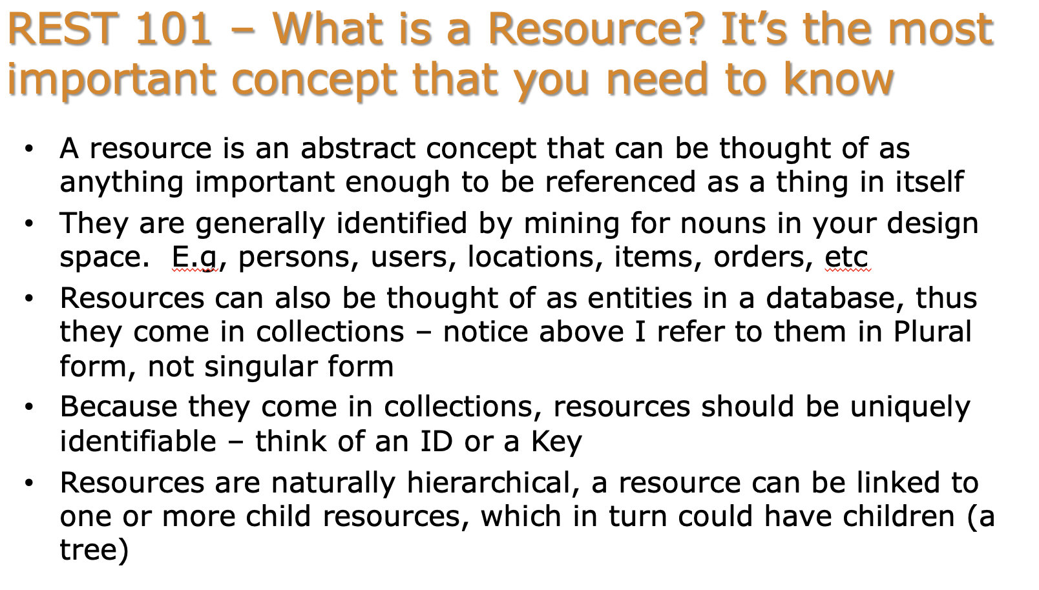
Finally GraphQL
Remember this slide – the definition of a resource, look at the 3rd bullet point “Resources can be thought of as entities in a database, …” Databases have standard Query langugages that can search and mutate data. Why cant we have the same thing for Resources? We can – its called GraphQL!

Slide 57
GrpahQL is a standard Query Syntax for Resources – Think SQL for Resources
Im not going to get into the details of the query language, google “GraphQL” and you will get a lot of content
GraphQL
Client
GraphQL Server
API Call
GraphQL Query over HTTP
POST
Your Code Get Data Resource 1
(Open Source) GraphQL Query Parser and Optimizer
Browser
File I/O
Your Code Get Data Resource 2
Database Query
Your Code Get Data Resource n
API
GraphQL Config Code
GraphQL Architecture
Your JS Code
GRPC STUB

Slide 58
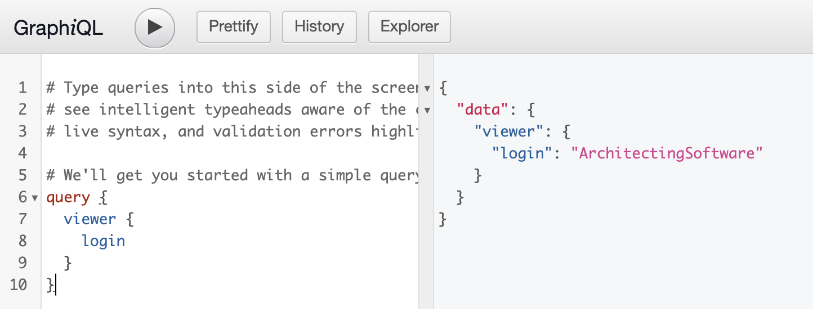
GrpahQL Query Examples
GitHub Supports GraphQL Queries
{
viewer {
repositories(first: 100) {
totalCount
nodes {
nameWithOwner
}
pageInfo {
hasNextPage
}
}
}
}
query {
viewer {
login
}
}
Try the GitHub API Playground at: https://docs.github.com/en/graphql/overview/explorer
Your JS Code
GRPC STUB

Slide 59
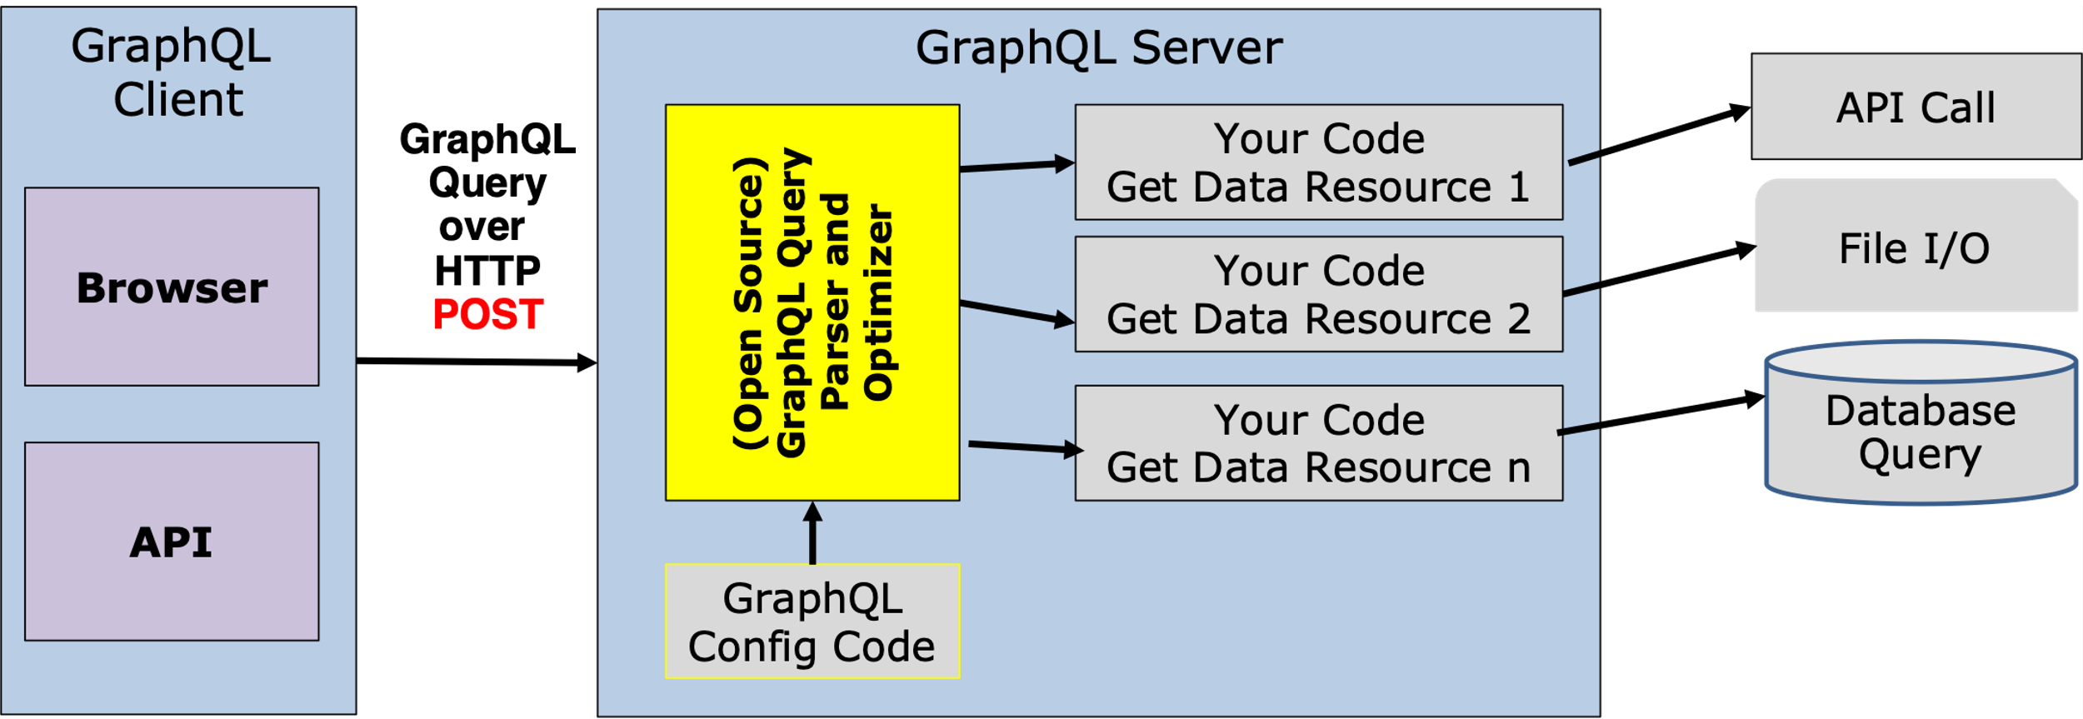
GraphQL Architecture Analysis
Is GraphQL good or bad from an architecture perspective
From a client usability perspective, its pretty awesome, GraphQL has an amazing query syntax – its extremely powerful – see: https://graphql.org/. There is not much NOT TO LIKE
However, from a server perspective, you introduce a pretty complicated piece of software – shown in yellow that parses and optimizes queries – the quality of libraries that supports this varies dramatically
You also need to write all of the code in gray that gets all of the data to execute the query. You have little control over the efficiency of the query request to return the desired response
Overall opinion – GraphQL is hard to get right as its hard to optimize, REST is much simpler, so you decide I am a fan in very specific situations only!

